Slide 1
Software Engineering Project
WallStreetBets Tracker
Jonathan Mendenhall
Daniel Tyree
Charlotte Hill
Ian Zheng

Slide 2
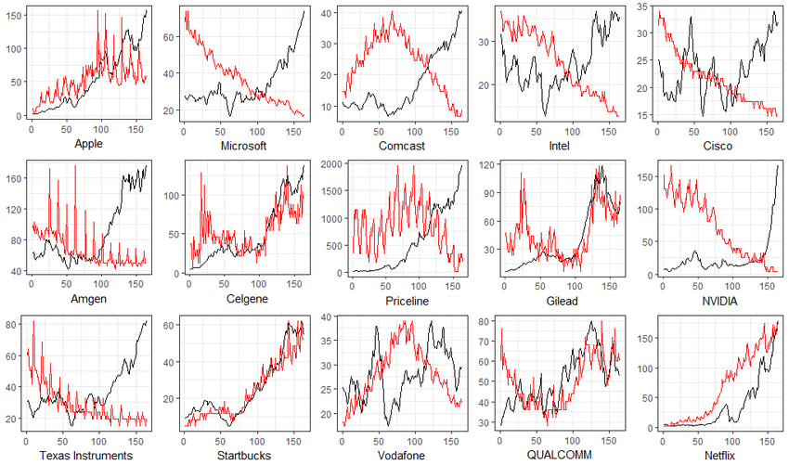
Product Overview
Many are not sure what stocks they should invest in.
Poor investments often result in lost money due to a poor knowledge and information.
WallStreetBets Tracker analyzes Reddit posts to find trends mentioned stocks
Allows users to take advantage of potential future stock price increases.
Notes:
Many are not sure what stocks they should invest in and are worried that investments they make may result in lost money due to a poor investment decision.
WallStreetBets Tracker is a web app that analyzes Reddit posts to find trends in different stocks, allowing users to take advantage of stock price increases due to mass market activity.

Slide 3
Target Audience
Anyone interested in individual investment in the stock market.
People who want to take advantage of the “hype waves” that can happen because of wallstreetbets posts and don’t mind the risk.
Individuals who are new to the stock market looking to find trends in specific “hyped” up stocks.
People who are interested in being connected to a broker and or to find a list of sources regarding trading.
Notes:
The WallStreetBets Tracker is an application that really anyone can use but is targeting more so for individual who are interested in the stock market & want to take advantage of, what many people call, “hype waves”.
These “hype waves” occur when specific, mainly high volatile stocks are talked about on different social media platforms and become trending.
This is where the WSBT plays its part by allowing users to see which stocks are being talked about before they blow up which can make it easier for a new investor to potentially make some money.

Slide 4

DEMO
Notes:
User Scenarios
Andrew Davis is a 21 year old who is interested in the stock market because of tweets and posts about GameStop giving people huge returns. He wants to know if people are still talking about GameStop and if it could be on the verge of another spike.
(look at GameStop for all time, to see the spike at end of January, then see that it’s not really talked about anymore… conclusion: probably not on the verge of another spike)
Mavis Brown is a homemaker and mother of 3 who does not have a lot of time to spend searching for stocks. She wants to know what stocks are more popular and narrow down her choices quickly so that the time she spends reviewing information about a stock gives her as much confidence as possible.
(look at top 5 stocks for past 30 days in all industries and see which ones are currently trending and view financial information for the top 1 of the list)
Thomas Smith is a verteran stock market trader who mainly invests in long term options, specifically for the transportation industry because he feels it is the backbone to commerce and trade as a whole. He is interested in day trading and would like to know more information about how stocks in the transportation industry could benefit him in the short term also.
(look at top 10 stocks for past 90 days in transportation)
John Doe is new to the stock market and doesn’t really know where to start. He keeps up with social media but there’s just too many things said by thousands of other people, so he wants a simple way to get an overview of what stocks people have been talking about across different industries.
(look at top 5 stocks for past 30 days in each of the different industries to get a broad idea of all industries)
User Stories
As a user, I want to be able to see the currently trending stocks mentioned by people.
As a user, I want to be able to view the trend in a specific stock over time.
As a user, I want to be able to view real financial data for stock trends.

Slide 5
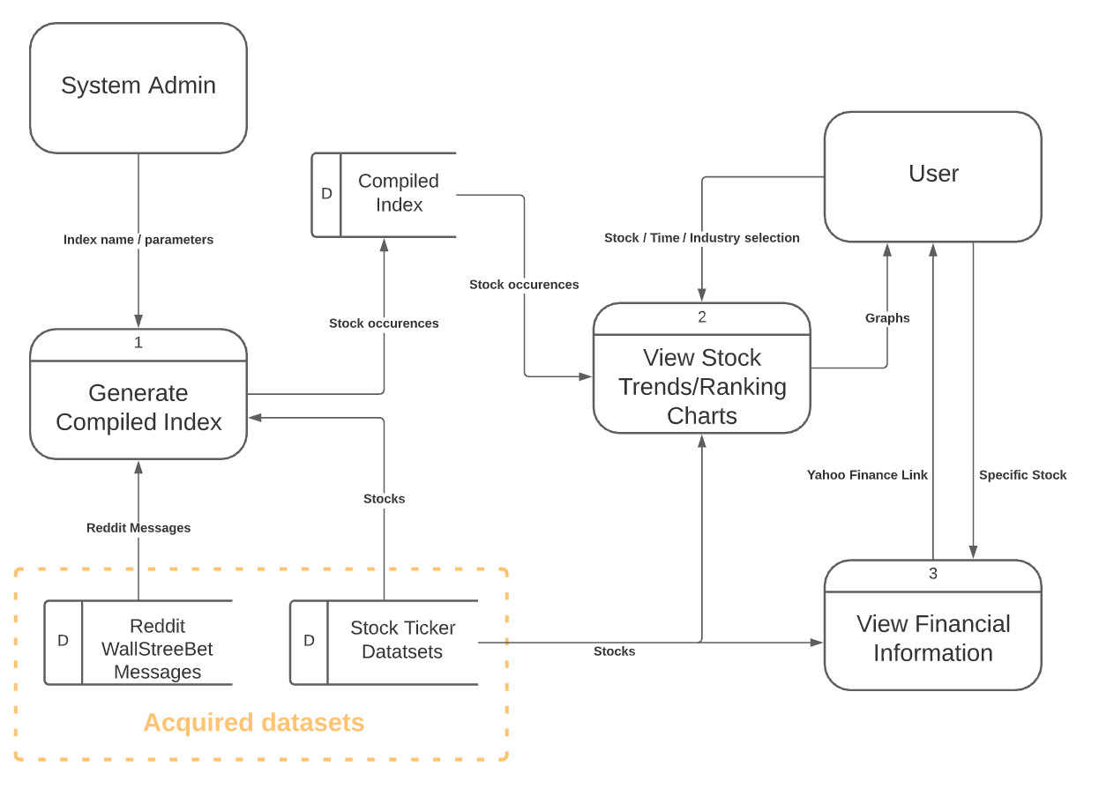
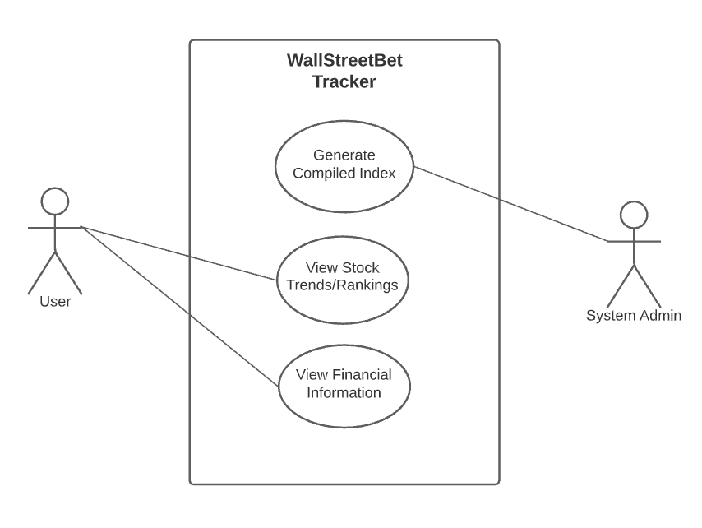
System Model
Notes:
General notes:
Use case diagram shows the high level overview of people interacting with the system
Data Flow Diagram (DFD) shows what data goes where when people are interacting with the system
Acquired datasets are the base datasets that the app uses
Probably walk through something like:
“
In our app, the role of the system admin is to generate the compiled index that powers the rest of the app for other users.
The system admin selects various parameters for the search algorithm, then the indexing process scans through all messages, looking for occurrences of thousands of stock symbols, and outputs an easy to read dataset of stock occurrences on each day.
The pre-compiled index enables users to have fast and high performance analysis when viewing stock trends in the app.
“
… explain rest of how user interacts with the app

Slide 6
Customer/Partner Team Feedback
All user stories were executed successfully and easily.
The application was fully capable of solving the target problem.
The app was intuitive, visually appealing, and cohesive.
The included features were implemented very well.

Slide 7
Enhancements / Future Work
Allow search stock trends when a specific phrase is mentioned.
E.g. find occurrences of stocks in messages that contain “to the moon”
Show financial data directly on the app
User is given more context about the market to make better decisions
Automatically scrape most current discussions from WallStreetBets subreddit
Current trends would always be available
Improve search algorithm to understand context of messages for
More accurate identification of stock trends
Expansion to track index funds
E.g. Dow Jones Industrial Average, S&P 500...

Slide 8
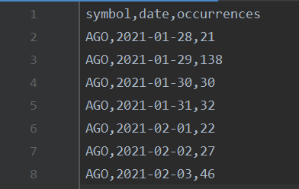
Major Challenges/Lessons Learned
Dealing with large datasets and maintaining performance is a common challenge in production applications
Reading through all of the messages takes a long time
Always work ahead of deadlines so potential challenges can be resolved with enough time.
Indexer
Notes:
The indexer was mentioned in the system model slide, so here just talk about how it relates to the “reading through all of the messages…” point

